Slide 1
Multi Cloud

Slide 2
MULTI-CLOUD MANAGEMENT
A multi-cloud management platform allows enterprises to manage workloads and applications across all cloud deployment models, including public, private, and hybrid.
Using the right platform for this workload enables enterprises to drive favorable business results.
The multi-cloud approach facilitates transition to the IT-as-a-Service (ITaaS) model, where IT departments act as service brokers and support organizations in optimizing their IT infrastructure consumption.
Additionally, cloud computing benefits such as cost savings, faster time to market, flexibility, and performance will compel the adoption of multi-cloud management in the future.

Slide 3
MULTI-CLOUD MANAGEMENT
Multi-cloud management is an open cloud platform delivered “as-a-service” to provide flexibility to the enterprises and enable the management of multiple cloud services such as IaaS, PaaS, and SaaS.
In the multicloud environment, enterprises can transfer their workload on multiple clouds, depending on the criticality of data and applications.

Slide 4
MULTI-CLOUD MANAGEMENT
Multi-cloud management is different from the hybrid cloud deployment model.
Hybrid cloud is an integrated service, provided both in-house and externally.
It is an amalgamation of private and public cloud, thereby offering the benefits of both the deployment models simultaneously

Slide 5
MULTI-CLOUD MANAGEMENT: KEY FEATURES
Feature | Meaning
Self-Service Provisioning | The user can choose the cloud computing environment as per the requirement with minimal intervention from the cloud service provider
Activity and Cost Information | The users are informed about the cost and activity of each CSP
Advanced Backup | The users can schedule the backups by defining the retention period, whether daily, weekly, or monthly
Schedule Tasks | The users can plan their tasks to be performed at defined intervals

Slide 6
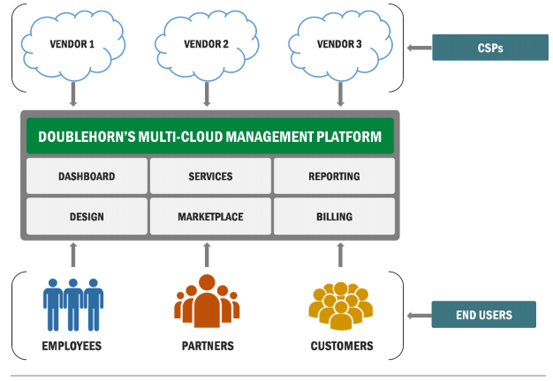
MULTI-CLOUD MANAGEMENT

Slide 7
MULTI-CLOUD MANAGEMENT: BENEFITS
Avoidance of vendor lock-in
Increased agility and automation
Achieving the right level of governance

Slide 8
MULTI-CLOUD MANAGEMENT: CHALLENGES
Lack of data security
Complexities in redesigning the network for cloud
Lack of expertise and management overhead

Slide 9
Case Study
A large pharmaceutical company used cloud services from a CSPs to speed up the time it takes to bring new pharmaceutical drugs to market. The applications were deployed on each of the cloud services as per the requirement for better control and usage. However, the company realized that a few of the cloud services are not being utilized efficiently while the cost remained fixed.

